Slide 1
WatchDog Design

Slide 2
Data Model
Event Lookup
Code
Value
Temp Current State
1 col for each sensor…
Timestamp
Event Current State
Row ID
1 col for each sensor…
Timestamp
x rows - static
1 row - static
Event History
Code
Timestamp
Temp History
1 col for each sesnsor
Timestamp
2 rows - static
x rows – dynamic
Needs purging
x rows – dynamic
Needs purging
External app 1: Update Event_Current_State Row 1
External app 2: Update Temp_Current_State
Trigger 1: Eval deltas in 2 rows of Event_Current_State and write to Event_History; Copy Row 1 to Row 2
Trigger 2: Insert Temp_Current_State values into Temp_History; Delete last row in Temp_History
Trigger 3: Purge Event_History every x days

Slide 3
Reports
Report 1: Temp Current State + History Graph
Report 2: Event Current State
Report 3: Event History List

Slide 4
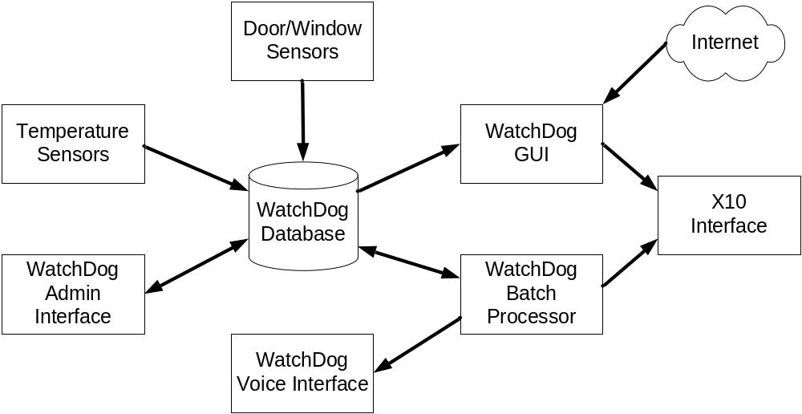
Module Overview

Slide 5
Functional List
Scan recipe, enter name and category
  ingredients list (optional) measurement, ingredient, Directions
Check house status
Operate lights via X10
  Auto schedule lights
  All external lights on X10
Address Book

Slide 6
Event Codes
2001 | Garage Door Open
2002 | Garage Door Closed
2003 | Garage Window South Open
2004 | Garage Window South Closed
2005 | Garage Window North Open
2006 | Garage Window North Closed
2007 | Garage Outside Door Open
2008 | Garage Outside Door Closed
2009 | Garage Outside Locked
2010 | Garage Outside Unlocked
2011 | Garage Inside Door Open
2012 | Garage Inside Door Closed
2013 | Garage Inside Unlocked
2014 | Garage Inside Locked
2015 | Kitchen Window Open
2016 | Kitchen Window Closed
2017 | Back Door Open
2018 | Back Door Closed

Slide 7
Event Codes
2019 | Back Door Unlocked
2020 | Back Door Locked
2021 | Great Room Window North Open
2022 | Great Room Window North Closed
2023 | Great Room Window South Open
2024 | Great Room Window South Closed
2025 | Play Room Window North Open
2026 | Play Room Window North Closed
2027 | Play Room Window South Open
2028 | Play Room Window South Closed
2029 | Family Room Window South Open
2030 | Family Room Window South Closed
2031 | Family Room Window Front South Open
2032 | Family Room Window Front South Closed
2033 | Family Room Window Front Middle Open
2034 | Family Room Window Front Middle Closed
2035 | Family Room Window Front North Open
2036 | Family Room Window Front North Closed
2037 | Front Door Open
2038 | Front Door Closed
2039 | Front Door Unlocked
2040 | Front Door Locked

Slide 8
Event Codes
2041 | Dining Room Window South Open
2042 | Dining Room Window South Closed
2043 | Dining Room Window North Open
2044 | Dining Room Window North Closed
3001 | Master Bath Window Open
3002 | Master Bath Window Closed
3003 | Master Bedroom Window Back South Open
3004 | Master Bedroom Window Back South Closed
3005 | Master Bedroom Window Back North Open
3006 | Master Bedroom Window Back North Closed
3007 | Master Bedroom Window South Open
3008 | Master Bedroom Window South Closed
3009 | Guest Bedroom Window 1 Open
3010 | Guest Bedroom Window 1 Closed
3011 | Guest Bedroom Window 2 Open
3012 | Guest Bedroom Window 2 Closed
3013 | Ethan Bedroom Window Open
3014 | Ethan Bedroom Window Closed

Slide 9
Event Codes
3015 | Sydney Bedroom Open
3016 | Sydney Bedroom Closed
1001 | Basement Door Open
1002 | Basement Door Closed
1003 | Basement Door Unlocked
1004 | Basement Door Locked
1005 | Basement South Window Opened
1006 | Basement South Window Closed
1007 | Basement North Window Opened
1008 | Basement North Window Closed
5000 | No Mail
5001 | Mail Delivered
5002 | Mail Retrieved
5003 | Event Log Started
5003 | Event Log Stopped
9999 | Error

Slide 10
Scheduled Events
ID | Description | Time
1000 | Send Status Update | 9:00 PM
1001 | Turn On Christmas Tree
1002 | Turn Off Christmas Tree
1003 | Turn On Garage Coach Lights | 5:00 PM
1004 | Turn Off Garage Coach Lights | 11:00 PM
1005 | Turn On Front Door Coach Lights | 5:00 PM
1006 | Turn Off Front Door Coach Lights | 11:00 PM
1007 | Turn On Back Door Coach Light | 5:00 PM
1008 | Turn Off Back Door Coach Light | 11:00 PM
1009 | Warn Garage Door Open | 9:00 PM
1010 | Warn Garage Door Open Reminder | 9:30 PM
1011 | Warn Front Door Lock Open | 9:01 PM
1012 | Warn Front Door Lock Open Reminder | 9:31 PM
1013 | Warn Garage Outside Door Lock Open | 9:02 PM
1014 | Warn Garage Outside Door Lock Open Reminder | 9:32 PM
Adjust for Winter/Summer?

